Slide 1
CIFAR-10 – Object Recognition in Images: Identify the subject of 300,000 labeled images Bo-Wen Xiao (蕭博文) Advisor: Prof. Chuan-Ju Wang (王釧茹)

Slide 2
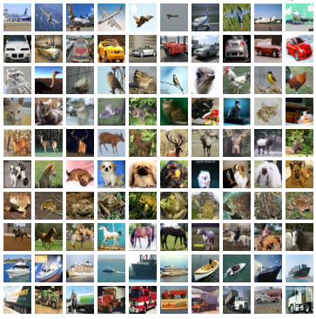
Abstract
This project aims to predict CIFAR-10 dataset which consists of 300,000 32*32 color images with one of 10 object classes.

Slide 3
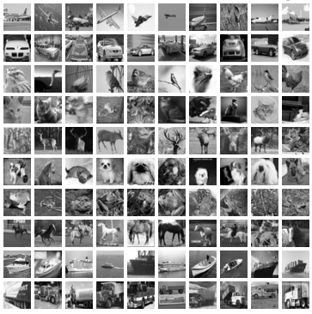
Dataset^{[1]}
10 label classes :
Airplane
Automobile
Bird
Cat
Deer
Dog
Frog
Horse
Ship
Truck
Training data: 50,000 labeled images
Testing data: 300,000 unlabeled images.

Slide 4
Preprocessing
Training set=[2][Number][Pixel]
Object Serialization
Data_Gray.pkl
Training set= [2][Number][[R][G][B]][Pixel]
Object Serialization
Data_RGB.pkl

Slide 5
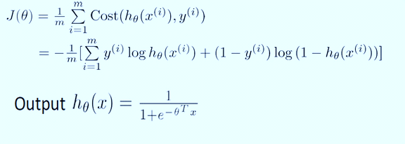
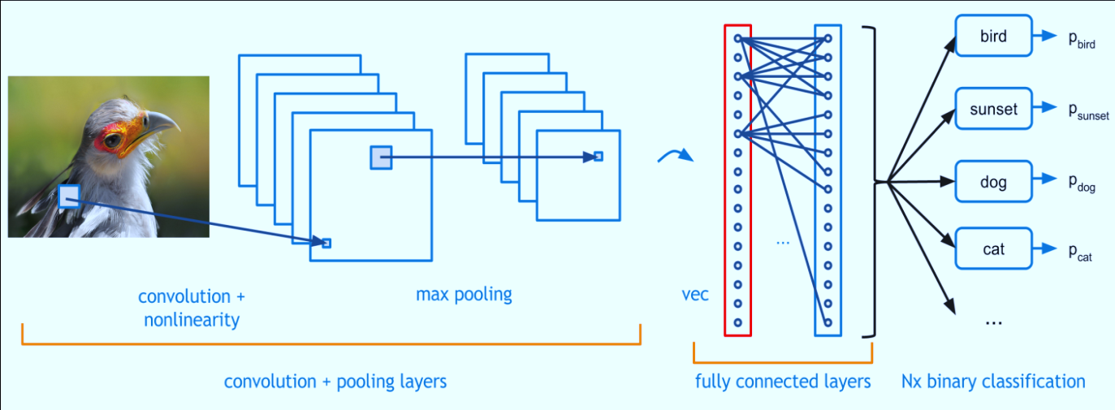
Deep Learning Algorithms^{[2]}
Tool: Theano^{[3]}
Logistic Regression^{[4]}
Convolutional Neural Networks^{[5]}
Data | Train | Valid | Test | Accuracy | Time
Gray | 30,000 | 10,000 | 10,000 | 26% | 32.2s
Gray | 40,000 | 10,000 | 300,000 | 10.08% | 23.55m
Data | Train | Valid | Test | Accuracy | Time
Gray | 40,000 | 10,000 | 10,000 | 58.2% | 814.42m
Gray | 40,000 | 10,000 | 300,000 | 59% | 1107.51m
RGB | 30,000 | 10,000 | 10,000 | 65.3% | 907.1m
RGB | 40,000 | 10,000 | 300,000 | 64.87% | 1891m

Slide 6
Deep Learning Algorithms^{[2]}
Different Batch Sizes
Training data: 3000
Validation data: 3000
Testing data: 9000
Different Training Sizes
Training : Validation: Testing
= 4 : 1 : 4
Accuracy
Batches Size

Slide 7

Evaluation
Measure : Mean Squared Error
1. Ŷ: predicted value
2. Y: true value
Accuracy$＝1­­­−\frac{1}{n}\sum_{i=1}^{n}{(Yi ­­­­­}$- Ŷ_{ｉ})^{２}

Slide 8
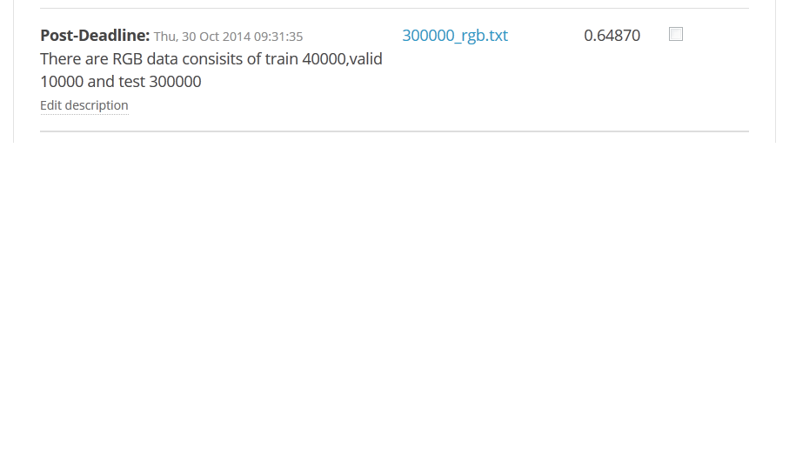
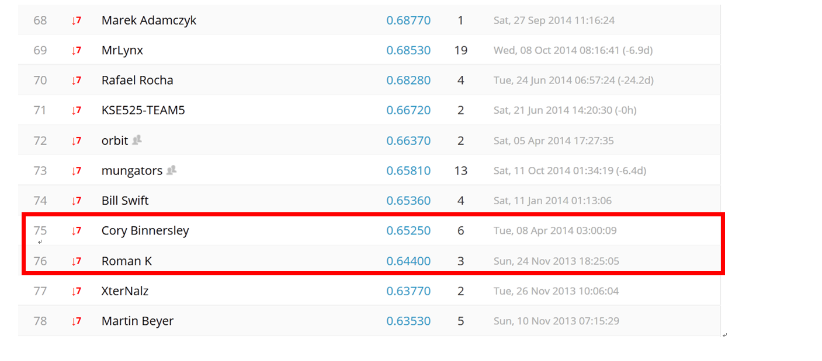
Leaderboard
[1] http://www.kaggle.com/c/cifar-10/data
[2] http://www.deeplearning.net/tutorial/contents.html
[3] http://deeplearning.net/software/theano/
[4] https://www.coursera.org/course/ml
[5] https://flickrcode.files.wordpress.com/2014/10/conv-net2.png

